Slide 1

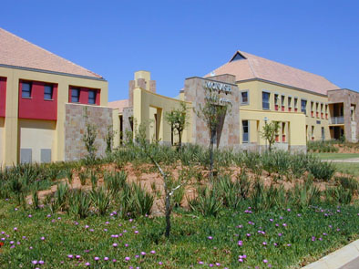
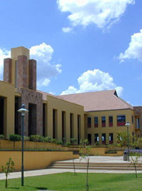

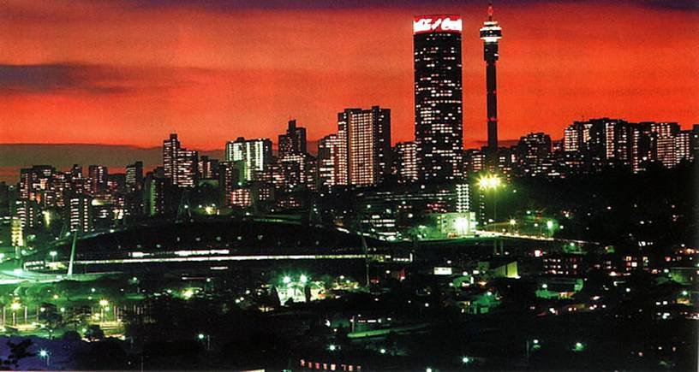
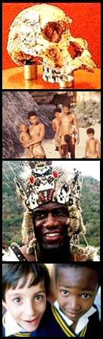
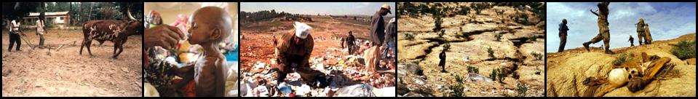
The Human Development Role of ICTs in Africa
A Presentation by Walter Brown: walbrown@mail.ngo.za: 26 July 2007
Notes:
166

Slide 2
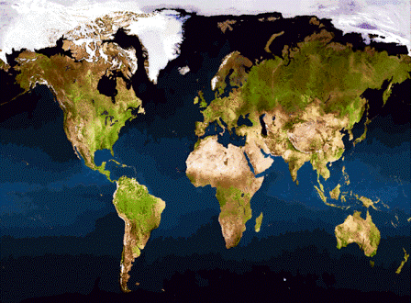
ICTs for Human Development
A Short History of Humans & ICTs
Africa’s ICT Performance
Consequences and Case Studies
The Way Forward
A Close Look at Africa
Notes:
166

Slide 3


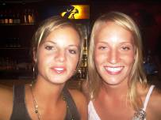
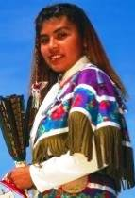


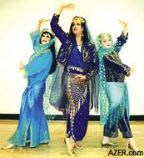

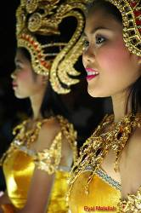

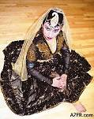
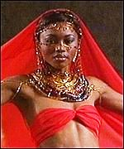

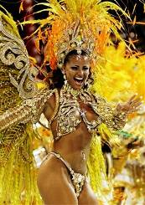
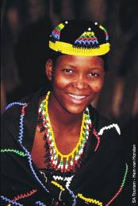
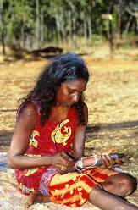
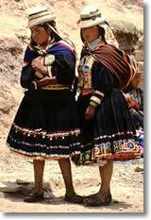
AFRICA:
Where it all Began
http://www.nationalgeographic.com
Everywoman’s Route to Today
25,000 Years Ago
67,000 Years Ago
50,000 Years Ago
20,000 Years Ago
85,000 Years Ago
The
Birthplace of Humanity….
Of Language….
Of Communication…
13,000 Years Ago
`
70,000 Years Ago
200,000 Years Ago
Now at the Bottom of the Human Development Pyramid…
Notes:
178

Slide 4
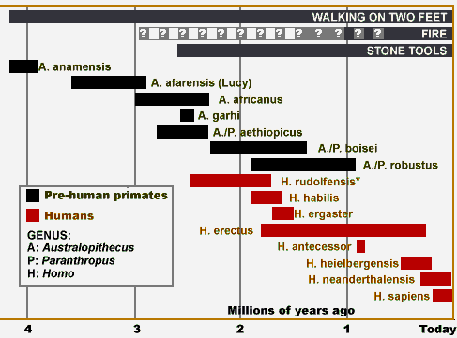

The Dawn of Knowledge: 200,00 years ago
Somewhere in Africa, about 200,000 years ago…
A Talking, Listening, Thinking Artistic Hominid Emerged
FOXP2 Mutated: Abstract Thought & Language
Notes:
178

Slide 5

The Birth of Human Communication:
Language
Last 200 years: Search for the Origins of Language:
  First in Europe, then in “Indo-Europe”????
  An Africa Origin? Nah! Africans had no souls, were not human!
Last 20 years: ICTs to the rescue:
  The Human Genome Project : A Global network of Scientists Connected by ICTs to overcome the Barriers of Language and Geographic Location
  Unearthed Africa’s “Mitochondrial Eve” and “Y Chromosome Adam”: our Ancient Ancestors who gave us all the power of language…..
Past six years: FOXP2 unravelled: The Language Trigger:
  A Tiny gene mutation 200,000 years ago
  It gave us the capability for Advanced Communications
  Modern Hominids Searching for & Accumulating Knowledge
  The World Changed Forever, For better or for Worse!
Notes:
178

Slide 6
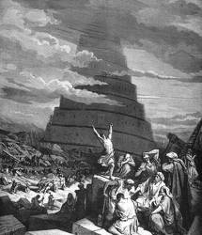
Updating the Ancient History of Language
"In the beginning was the Word, and the Word was with God, and the Word was God" (Gospel of John): Christian, Jewish, Islamic Belief
Mankind Abused God’s Word: Built the Tower of Babel
God punished this foolishness: A Global Multi-lingual Plague: The Biblical “Babble of Tongues”
Curse of multi-lingualism: Wars; Slavery; Racism; Religion; Global warming; Extinction of many species; African Poverty & Depravation.
God took pity, and sent Messengers………..
Samuel Morse, Alexander Bell, Mr Bill Gates and other ICT gurus: ICTs “Converge” to Converge the Babble of Tongues…
Some nations accepted God’s gift and prospered……
Africa, God’s “Human Laboratory”….. Ignored God’s Messengers: Depravation Continues: A bleak future as Climatic Changes Threaten……..
Notes:
178

Slide 7
Africa’s Major 21st Century Challenge: Language
Africa’s Children at a Massive Disadvantage …..
They MUST Learn to Learn in a foreign tongue……….
Traditional Educational Systems WILL NOT cope!
Can ICTs Be Used to bridge this Massive Divide?
Many Lack Access to Primary Education in their mother Tongue
Many Lack Access to Primary Education in their Mother Tongue
Region or Group
Region or Group
Number of
Number of
Population with Access to Education in
Population with Access to Education in
Total population
Total population
Spoken languages
Spoken languages
Mother Tongue in 2000
Mother Tongue in 2000
(Millions
(Millions
(Per M)
)
(Per M)
)
Sub
A Massive Human Development Challenge
Sub
-
-
Sahara
Sahara
2,632
2,632
641
641
(4.1)
13%
(4.1)
Africa
13%
Africa
East Asia &
East Asia &
62%
2,185
62%
2,185
1,918
1,918
(1.1)
Pacific
(1.1)
Pacific
South Asia
South Asia
811
811
1,480
1,480
(0.55)
66%
(0.55)
66%
C. & E. Europe
C. & E. Europe
625
625
409
409
(1.5)
74%
(1.5)
and the CIS
74%
and the CIS
High income
High income
87%
1,299
87%
1,299
912
912
(1.4)
OECD
(1.4)
OECD
Latin America &
Latin America &
1,086
1,086
530
530
(2)
91%
(2)
Caribbean
91%
Caribbean
Source: SIL international 2004
Source: SIL International 2004
Notes:
70

Slide 8




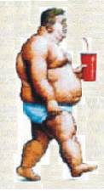


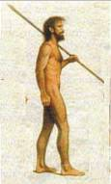


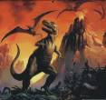
The Rise & Rise of Knowledge
128
Africa 2015
MDGs Closer
Inequalities Reduced
Economic Growth Assured
As the knowledge front-runners accumulate more knowledge via smaller microchips and faster electrons & photons..
70
It took from the time of Christ to the mid 18th Century for Human Knowledge to Double.
It doubled again 150 years later…..
And then again in only 50 years.
In 1990, human knowledge doubled every 4 to 5 years……
How fast Today?
David Linowes,
1990
Knowledge Society
60
64
50
The laggards slip further behind, unable to deal with new challenges and
threats unraveling
every day…
40
2015 A. D. – Millennium Development Goals
Rock ‘n Roll
30
32
20
Technology
Grunts
Weapons
16
10
Speech
8
Human Knowledge Capacity Multiplier – Ref. 20m years ago
0
1
4
0
2
350m BC
20m BC
200,000 BC
0 BC
1800 AD
1950 AD
2000 AD
2005 AD
“Nations that do not keep pace with ICT Developments Begin each Day at a Global Disadvantage in Every Aspect of Development & Growth” (UNDP)
Notes:
199

Slide 9
Africa’s Massive Human Development Divide
UNDP 2006: Human Development Indicators
Lowest Rank
Niger:177
0%
0%
3%
0%
5%
5%
62%
54%
76%
Haiti: 154
China 81
Yemen: 150
28 African Nations
Middle East & N. Africa
S. Africa: 121
L. America & Caribbean
58%
55%
Western Economies
Former Eastern Bloc
Sub-Sahara Africa
Asia & Pacific
95%
46%
39%
40%
24%
33%
4%
High HDI
Mid HDI
Low HDI
Mauritius
63
Seychelles
46
1-63
64-146
147-177
The Cradle of Mankind
Source: UN HD Report 2006
Has NOT kept pace with Knowledge
for its Own Development
Notes:
78.5
Africa lags the rest of the world in terms of human development:
78% of all African countries feature low levels of human development – Low Human Development Index (HDI) ranks 146 to 177;
20% African countries are classified “Medium HDI”, ranks 58 to 145;
One African country, the island of Seychelles, ranks a “high” HDI classification of 51 out of 58.
Norway leads the world in human development, with a Human Development Index rank of 1.
Clearly, Africa has not built networks through which the continent can access knowledge for its own development.
“Africa's biggest challenge, if it is to compete in the global economy, is its deficit in human capital. Economic strength used to depend on size or command over natural resources. Now it depends on the quality and skill level of the labour force: the ability to cope with complex production techniques and technological change. It requires the workforce to be educated and also healthy” (Larry Elliott Friday March 11, 2005 The Guardian - Commentary on the publication of the 2005 UN Human Development Report)

Slide 10
Africa’s Civil Society Challenges: Economy
High Population Growth
2000: 14%
High Poverty Growth
2000: 2%
1980: 11%
1980: 4%
More Trouble Looming for Africa
Urgent Repair Tools Needed
2%
14%
12%
36%
4%
20%
11%
40%
14%
14%
Population
1980 (inner)
2005 (outer)
GDP
1980 (inner)
2005 (outer)
36%
35%
56%
21%
59%
25%
Percentage of World
Africa
Americas
Asia Pacific
Europe

Slide 11
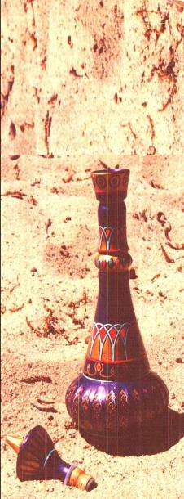

Africa’s Civil Society Challenges: GINI Coefficient
The Biggest Barrier to Social Cohesion
Major Contributor to Civil Instability & Crime
Major Contributor to low economic growth
Simplified Definition: 0 GINI, all share national wealth: 100 GINI, One Person has all national wealth
Knowledge For ALL – Surest way to control GINI: Achieve MDGs
xx
Human Development Index Rank
Source: UN HDI Report 2006
Extremely Dangerous GINI
Like a Red Flag to an Angry Bull
Denmark
15
25
69
58
Brazil:
Japan
7
25
70
58
Colombia:
Sweden
5
25
121
58
South Africa:
Norway
1
26
91
58
Paraguay:
Czech Rep.
30
25
154
59
Haiti:
Slovenia
42
26
115
60
Bolivia:
Germany
21
28
146
61
Swaziland:
Finland
11
27
131
63
Botswana:
Slovakia
42
26
149
63
Lesotho:
Hungary
35
27
125
74
Namibia:
0
10
20
30
40
50
60
70
80
World’s Lowest 10
Gini Coefficient
World’s Highest 10
Notes:
220

Slide 12
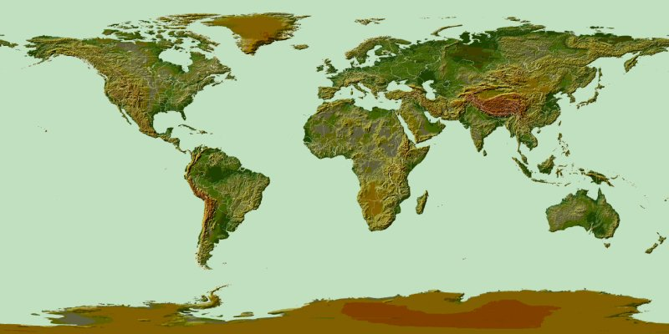
Africa's Access to Knowledge
A Statistical Review
100
80
Mobile: 85%
100
60
40
Fixed: 41%
Internet: 34%
80
20
60
Mobile: 23%
0
40
Fixed: 16%
Internet: 10%
20
0
100
Fixed: 3%
80
60
Mobile: 15%
40
Fixed
34%
Mobile
52%
Internet
32%
20
0
100
80
Mobile: 69%
Internet:
4%
60
Internet:
52%
40
Fixed: 42%
20
0
Source: ITU 2005
Africa Needs Advanced Knowledge Fast: Effective ICTs a Vital Tool!
Notes:
137

Slide 13
Infrastructure Costs:
Capital Cost of each Additional Main Line Telephone in Developing Countries
$10,000
$9,000
The Poorest countries pay the highest prices to build the most critical human development tools: Knowledge delivering ICTs
$7,998
$8,000
$7,000
$6,380
$5,798
$6,000
$5,000
$4,000
$3,394
$2,861
$2,858
$3,000
$2,426
$1,984
$1,685
$1,786
$2,000
$1,102
$874
$1,000
$-
Argentina
Brazil
Chile
Thailand
Pakistan
India
China
Nigeria
Kenya
S. Africa
Ethiopia
Colombia
Source: ITU World Telecommunications Indicators 2004
Calculation: Total Investment in Fixed Line Services/Additional New Lines (1975-2000)
Little evidence of concerted African attempts to reduce excessive capital costs
Next Generation Networks offer Invaluable Opportunities for cost reduction

Slide 14
Africa: Priced Out of Development: Telephony
Chart 9:Telecommunication User Prices (2003)
$100
103
69
28
121
73
36
75
108
$88
$90
35
57
32
58
43
34
49
37
$80
$49
$70
$47
$60
$40
$50
Monthly Prices (Rental + 10 hour basket)
45
$40
40
$30
32
Fixed > 50km
Fixed Local
29
Fixed Pre-paid
$20
22
25
Cell Pre-paid
18
16
26
$10
10
14
11
11
5
10
6
$0
South Africa
2005 Tariffs
Algeria
Colombia
S. Korea
S. Africa
Thailand
Poland
Venezuela
Viet Nam
(ITU WTI 2004 Report: Data for 2003)
Cell Basket
Fixed Basket
XXX
HDI Rank
XX
GINI Index
Eight Developing Countries…
South Africa: Highest HDI: Highest GINI: Highest ICT Prices
Is Development with Costly Knowledge Possible?

Slide 15
Africa: Priced Out of Development: Broadband
Fixed or Mobile
With Broadband Prices 440 times “Global Best Practice”
Will We Ever Catch up with Knowledge Front Runners ?
South Africa Gamco Express (IS) | 1,024 US$450 US$44 | ?
Price Breakdown: ADSL Line Rental – US$65 per month: ADSL Service: US$385: Xch. Rate: 7:1
Source: http://www4.gam.co.za Accessed: 10 October 2006
Notes:
102

Slide 16
Consequences
Ignorance is NOT Bliss!
Knowledge = Power = Progress
Ignorance = Everything Negative & Wrong
Ignorance of Who We Are;
Our Common Ancestry;
Our Genetic Equality =
Racism & Slavery; Apartheid; Tribalism; Ethnic Conflicts, Wars & Genocide; Global Terror…….

Slide 17
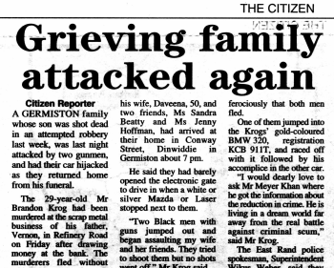
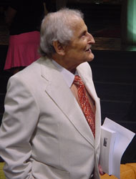
Violence & Crime: Bitter Fruits of Social Divides
Human Species Predisposed to Extreme Violence: And Great Sympathy & Caring
Culture & environment determines where we are……
“Must we wait 1000 years for genetic evolution to breed out our propensity for violence?”
“Only if we are helpless products of our genes….”
But: We are masters of our culture & society: We can change them in favour of Sympathy & Caring over violence: We can defeat Crime & Violence……
Professor Phillip Tobias – South African & Internationally Celebrated Scientist.
We CAN re-create ourselves as a less violent species, BUT we need Knowledge for Socio-Inclusion to do this…..Affordable Ubiquitous ICTs
Notes:
146
Africa lags the rest of the world in terms of human development:
78% of all African countries feature low levels of human development – Low Human Development Index (HDI) ranks 146 to 177;
20% African countries are classified “Medium HDI”, ranks 58 to 145;
One African country, the island of Seychelles, ranks a “high” HDI classification of 51 out of 58.
Norway leads the world in human development, with a Human Development Index rank of 1.
Clearly, Africa has not built networks through which the continent can access knowledge for its own development.
“Africa's biggest challenge, if it is to compete in the global economy, is its deficit in human capital. Economic strength used to depend on size or command over natural resources. Now it depends on the quality and skill level of the labour force: the ability to cope with complex production techniques and technological change. It requires the workforce to be educated and also healthy” (Larry Elliott Friday March 11, 2005 The Guardian - Commentary on the publication of the 2005 UN Human Development Report)

Slide 18
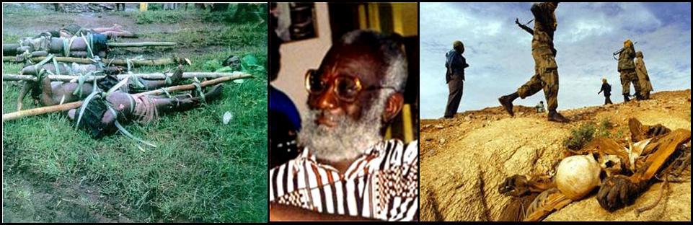
African Violence, War & Crime: A 21st Century Tragedy
Darfur
Rwanda
EXTRACTS FROM “THE AFRICAN ELITES”:
Ethos of admiration for the educated replaced by wealth accumulation & conspicuous consumption
Access to wealth by fair means or foul: Corruption, graft, greed becoming Societal Norms
Educated people unable to feed their families while Corrupt Public Figures flaunt ill-gotten wealth
Plundering of state coffers intensifies: Expanding pauperisation of the masses
Emergence of armed gangs, thugs and warlords who compete with the others for resources in collapsing economies”. (Kwesi Kwa Prah – African Wars and Ethnic Conflicts – Rebuilding Failed States….UNDP Background Paper for HDR 2004)
Knowledge based Societies Overcome such Horrors……
Notes:
318
Africa lags the rest of the world in terms of human development:
78% of all African countries feature low levels of human development – Low Human Development Index (HDI) ranks 146 to 177;
20% African countries are classified “Medium HDI”, ranks 58 to 145;
One African country, the island of Seychelles, ranks a “high” HDI classification of 51 out of 58.
Norway leads the world in human development, with a Human Development Index rank of 1.
Clearly, Africa has not built networks through which the continent can access knowledge for its own development.
“Africa's biggest challenge, if it is to compete in the global economy, is its deficit in human capital. Economic strength used to depend on size or command over natural resources. Now it depends on the quality and skill level of the labour force: the ability to cope with complex production techniques and technological change. It requires the workforce to be educated and also healthy” (Larry Elliott Friday March 11, 2005 The Guardian - Commentary on the publication of the 2005 UN Human Development Report)

Slide 19
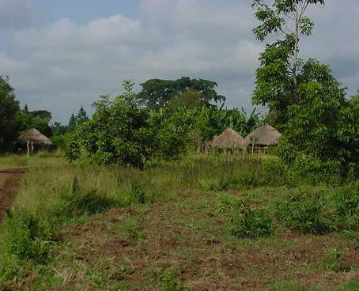
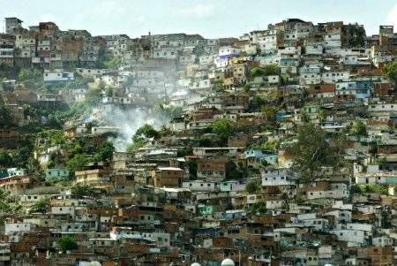
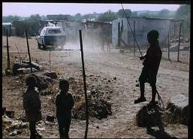
Urbanization: A 21st Century Threat
Moving from Here
To Here
An Irreversible 21st Century Scourge - Driven by:
  Population Growth: 2 Billion MORE to look after by 2015!
  Unsustainable Rural Lifestyles: Impact of Globalisation, Technology
  Competition for Commercial use of Land: Potential Economic/Social Disaster
Advanced Knowledge for Social Development Vital to Avert Disaster
Knowledge Accessed & Disseminated Via Effective, Affordable ICTs
Notes:
147

Slide 20
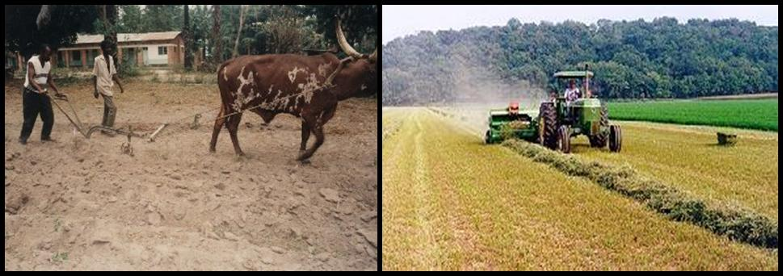
Agriculture: A 21st Century Challenge
An Unstoppable Global Trend
Rising Urban Population Demands Vast Quantities of Food:
  Supermarkets replace Grocers-Demand Delivery, Quantity, Quality Guarantees
  1st World Trade Policies & Farm Subsidies render Rural Farmers Un-competitive
  Rural Farmers Migrate to Cities, often Shanty Dwellings in African Capital Cities
  Job Losses in Rural Areas, Few jobs for unskilled Workers in Urban Areas
Complex Economic and Social Engineering Knowledge Demanded – Accessed Easily via Affordable Global ICT Access Links
Notes:
221

Slide 21
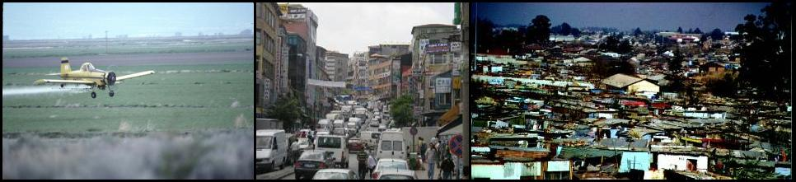
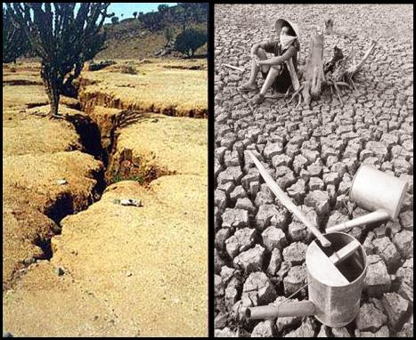

Environment: A 21st Century Threat
Chemical; Water; Eco-balance
Co2; Urban Waste
Water; Co2; Surface Drainage; Garbage; Disease; Many More
Soweto
Environmental & Ecological Damage
On the Farm: Excessive Use of Water, Destruction of indigenous flora & fauna, Chemical pollution…..etc……..etc….
In the Cities: Co2 Emission & air pollution; Water Pollution, overuse, wastage; natural drainage destruction; garbage disposal deficiencies; human & cross-species diseases……ecological damage….
Advanced Knowledge Needed for Prevention, Management & Reversal
Access to and Effective Dissemination of Advanced Knowledge Critical for SURVIVAL!
Homo Sapiens CAN avoid or survive this….
But only with Advanced Knowledge for Development Shared by MANY……..
Notes:
517M

Slide 22

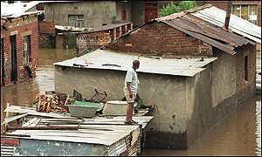
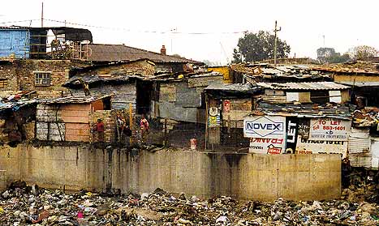
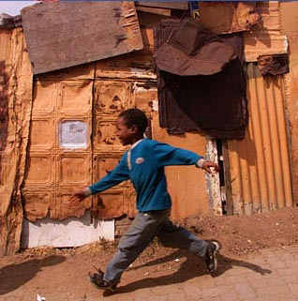
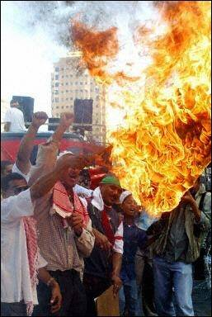
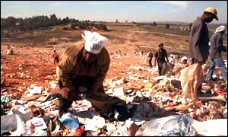
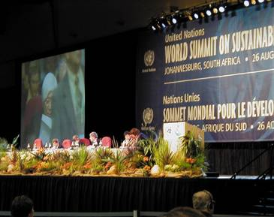
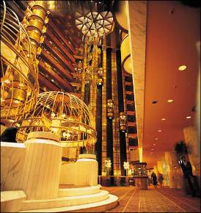


An Urgent Call for Action
Tired of Waiting
While World Leaders, Intellectuals, Hangers-on, Businesspersons, Politicians, Delegates Gather in the Luxuries of Sandton City, Jomo Kenyata Conference Centre, Abudja, Addis Ababa, Geneva… Discussing
World Summits on Sustainable Development, ICT Pricing, WSIS, Global Warming, ICT Billing, Urbanization, NGNs ………
Sad way to feed your family
Home Sweet??? Home!
Seeking Knowledge
Oh No! Not Another Flood
Three Km. away in Alex, They do not listen, They know not how……….
An Environmental Challenge
Notes:
South Africa (HDI Rank: 120): A Golden Opportunity – A Major Challenge
South Africa’s unique strengths:
The “Cradle” of humankind (Sterkfontein), and Modern Humans (Kalahari);
A Microcosm of a multi-ethnic multi-cultural “colourful” world that finds strength in cultural diversity;
A nation rich in historical experience - a disastrous human history presenting a powerful messages for the future;
A land rich in natural resources – human and other;
A significant “First Economy” that can contribute to “Second Economy” development – if allowed to, and encouraged to do so.
South Africa’s risks:
Failure to raise the national level of human development;
The consequential response of the massive “Second Economy” to its “exclusion” from “First Economy” advantages;
Failure to build the tools required for inclusive human development – affordable effective ICTs.
South Africa’s opportunity: Use the intellectual capacity of South Africa’s “First Economy” to build the ICT infrastructures that will address the knowledge access needs of South Africa’s “Second Economy” – true ICTs4D4ALL, addressing leading edge economic challenges, and developing country demands simultaneously, effectively.

Slide 23
A Few Case Studies
Success: South Korea
  From Abject Poverty to World Knowledge Network Leader in just 23 years
Ancient Total Failure: Easter Island
  They Denuded their Forests, then ATE each other
Failure = Learning = Success: Iceland
  Disastrous early failures reversed: Rank 2 in HDI
Modern Failure: Haiti
  One Island: Same History: Vast Differences: Haiti & Dominican Republic
Today’s Roaring Giant: China
  Tomorrow’s Global Power

Slide 24
Case Study 1:
The Tale of Three Similar Countries: Same Population
Internet Users per 100
International IP Bandwidth G/bs
70
70
The Economy “Took Off”
From mid-1980s
US$178 in 1970
  US$10,014 in 2003
60
60
120
50
50
Driven by ICT Growth
One Family One Phone Policy
More Productive
People
40
40
100
100
30
30
80
20
20
10
10
60
54
0
0
40
1995
2001
2002
2003
2001
2002
2003
South Korea
South Africa
Egypt
20
23
Demographics:
Egypt, South Africa, South Korea Similar Populations
13
11
0
1970
1980
1990
2002
1970
1980
1990
2002
GDP/Capita (US$X100)
Main Line Density (%)
Wealth (GDP/Capita): Years 1970 to 2000
Egypt: $187 to $1,544
South Africa: $778 to 2,928
South Korea: $278 to $11,127
Source: ITU World
South Korea
South Africa
Egypt
Indicators 2004
Change Triggers: Maitland Commission: The Missing Link – 1984
Break-up of AT&T and Competition in Basic Services - 1984
South Korea began Planning their ICTs & Migration Strategies in 1985: The Korean BCN Project!

Slide 25
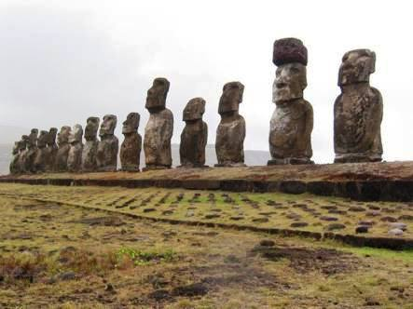
Case Study 2
– Valuable Lesson from History
Just 600 years ago - They carved stone statues 65 feet tall, 270 tons – The only remnants of a brave society - gazing across the ocean - wondering what went wrong..... They lacked knowledge for sustainability
“In just a few centuries, the people of Easter Island wiped out their forest, drove their plants and animals to extinction, and saw their complex society spiral into chaos and cannibalism. Are we about to follow their lead?” (Jared Diamond, in Discover Magazine August 1995)
Notes:
State Collapse – Lessons from History
I studied history in school, a rather skewed history comprising 80% or more of the history of my nation’s colonial power’s successes, not its failures.
My first encounter with the “mysteries” of Easter Island was through private readings – Erich von Daeniken’s theories that beings from outer space built the immense stone statues so visible on Easter Island, as they “created” the human species through their advanced scientific knowledge.
The Mysteries of Easter Island were clarified through my encounter with the World Wide Web – I “chose” to become better informed of the threats of knowledge misuse on the survival of states and nations. (Recommended Websites: Too many to list – 15 minutes search via Yahoo or equivalent will be most informative, all alternatives will be very costly and time consuming).
The socio-political leaders of Easter Island chose national suicide just 600 years ago – they destroyed their environment, and assigned their sophisticated society to extinction - and useful inputs for best-selling authors of fiction. Serious scientific researches and publications receive far to little attention by many of today’s socio-political leaders, often racing in ignorance to repeat the errors of the ancient Easter Islanders.
Advanced human knowledge needs to be “freed” from the confines of academia and libraries inaccessible to those who need to know most – the ICTs do this most effectively.

Slide 26
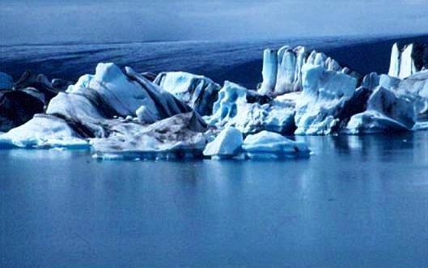
Case Study 3:
Failure ➔knowledge ➔ Success
ICELAND – Second Most Successful Country on Earth
Iceland: Human Development Index Rank: 2
A Cold un-forgiving land
Extremely fragile ecosystem
First settled around 870 AD
Early attempts at agriculture were disastrous
Serious environmental degradation – repeated human disasters
Icelanders learned – environmental damage is being reversed
Iceland’s disasters turned to success
Two Countries Same Populations |  | 1970 | 1980 | 1990 | 2000
GDP Per Capita $ | Iceland | 2,437 | 14,266 | 24,450 | 29,797
 | Cape Verde | 145 | 369 | 789 | 1,286
Tele-density % | Iceland | 28 | 37 | 51 | 68
 | Cape Verde | ---- | 0.5 | 2.4 | 12.5
IP User Density % | Iceland | ----- | ----- | 0 | 60
 | Cape Verde | ----- | ----- | 0 | 1.84
Notes:
State Collapse – Lessons from History
I studied history in school, a rather skewed history comprising 80% or more of the history of my nation’s colonial power’s successes, not its failures.
My first encounter with the “mysteries” of Easter Island was through private readings – Erich von Daeniken’s theories that beings from outer space built the immense stone statues so visible on Easter Island, as they “created” the human species through their advanced scientific knowledge.
The Mysteries of Easter Island were clarified through my encounter with the World Wide Web – I “chose” to become better informed of the threats of knowledge misuse on the survival of states and nations. (Recommended Websites: Too many to list – 15 minutes search via Yahoo or equivalent will be most informative, all alternatives will be very costly and time consuming).
The socio-political leaders of Easter Island chose national suicide just 600 years ago – they destroyed their environment, and assigned their sophisticated society to extinction - and useful inputs for best-selling authors of fiction. Serious scientific researches and publications receive far to little attention by many of today’s socio-political leaders, often racing in ignorance to repeat the errors of the ancient Easter Islanders.
Advanced human knowledge needs to be “freed” from the confines of academia and libraries inaccessible to those who need to know most – the ICTs do this most effectively.

Slide 27
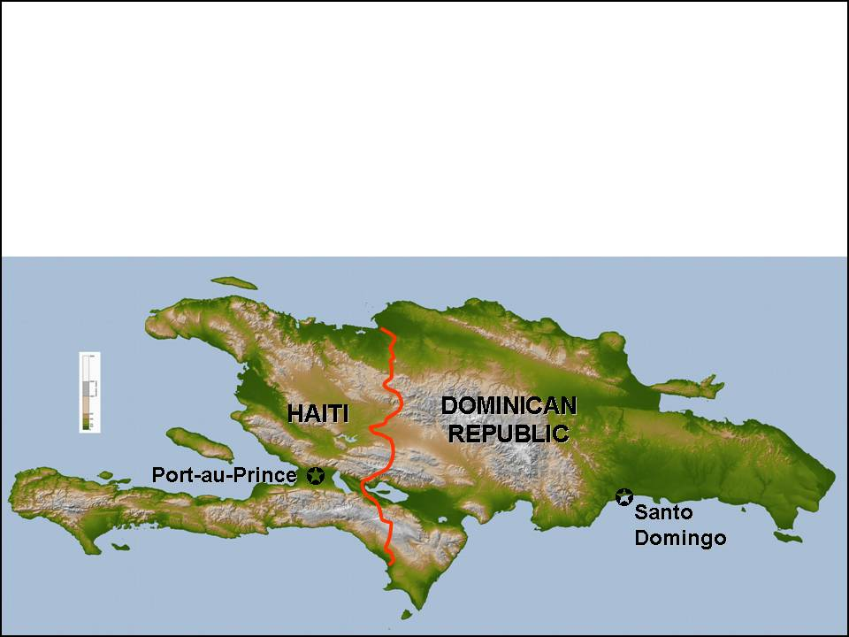
Case Study 4: Haiti
Two Identical Countries
Different in All Respects
Same Disgraceful Colonial History: Spain circa 1500 AD, France from 1550
Local ARAWAK Population: All 500,000 dead by 1520
About 1million African Slaves by 1785: Successful Revolution 1800s
Country Renamed Haiti: Zimbabwe-style Infrastructure & Land Reforms;
“Dominican Republic” Retained International links & colonial infrastructure
Inept & Corrupt Leadership on Both Sides: Environmental Sensibility in DR!
Population: 8.4M
Population: 8.8M
Severe Environmental Degradation Massive Deforestation
Significantly lower
Environmental
Degradation
The Island of Hispaniola
Human Development Rank: 154/177
Human Development Rank: 94/177

Slide 28
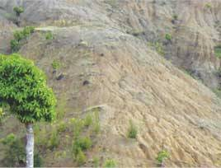
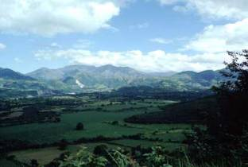
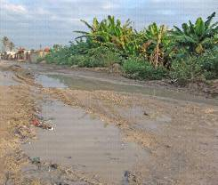
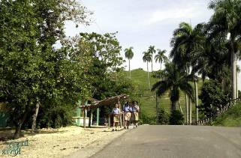
Case Study 4: Haiti:
The Environment
Statistics
Country | Population | GDP/Capita | Fixed Density | Mobile density | IP User Density
Dominican Republic | 8.8 Million | $2,586 | 12% | 27% | 10%
Haiti | 8.4 Million | $380 | 2% | 4% | 2%
Severe Deforestation
Lower Deforestation
Haitian Rural Road
Dominican Republic Rural Road

Slide 29
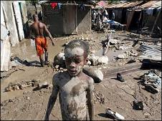
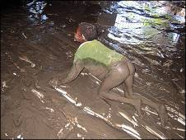
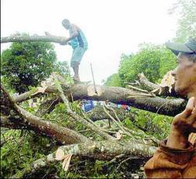
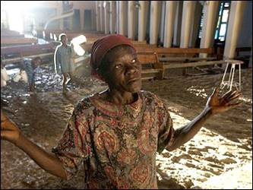

Case Study 4: Haiti:
Jeanne: A Very Angry lady
September 2004: Hurricane Jeanne Lashes the Island of Hispaniola
Haiti: Massive Devastation: Massive Floods & Mudslides: More than 2,000 fatalities: Collapse of Governance, Law & Order: Total national chaos & instability
Dominican Republic: Greater hurricane readiness: 20 Fatalities
Haiti: Deforestation Contributed Directly to Scale of Disaster
Dominican Republic: Forest Cover helped reduce Jeanne’s Fury
Greater Readiness
Forest Cover Reduced Impact
A massive Human Disaster

Slide 30

Case Study 5: – The Sleeping Giant Awakens
Economic Growth: 10% per annum: HD Rank: 81/177
China | 1980 | 1990 | 2000
GDP/Capita $ | 399 | 332 | 833
Mobile  | 0 | 18,319 | 85,260,000
IP users |  | 0 | 22,500,000
Main  | 2,140,700 | 6,850,300 | 144,828,992
PCs |  | 500,000 | 20,600,000
TVs | 5,000,000 | 180,000,000 | 394,000,000
Population | 982m | 1,200m | 1,300m
Massive Environmental Degradation
Stemmed by Growing Knowledge
Accessed
Via
ICTs
MDGs Achieved: China’s Poverty Halved in just 10 years
Satellite Picture: Dust cloud over China, Japan, Korea
Source: www.china.org.cn

Slide 31
The Way Forward
Change Africa’s Relationship with ICTs
  ICTs: Simple Extension of Language: NOT complex Mystical Technology
  Most Powerful Cost-effective Knowledge Access Tools
  Knowledge Networks that USE technology, NOT Technological Networks that DEMAND knowledge
Focus R&D on the Human Factor
  Access to Knowledge is a Human Right
  Human Ignorance, Greed, Obstinacy the ONLY barrier
Remove Man-made Barriers
  Rigorously Research Ways of changing mindset of Africa’s Political Leadership: Human-focused ICT Policy Reforms
  Demystify ICTs: A Powerful Development Tool, NOT a Mystical Acronym and Jargon-filled Complex Technology
  Seek Viable Pro-poor Architectures & Applications

Slide 32
The Way Forward
A Short Review of Information and Communication Technologies
A Broad Picture of the Whole: Very Little has Change!
Circuit Switched Space/Time Networks & Technologies:
  “Invented” nearly 150 years ago: Africa still trying to find a connection
  Did Africa have to wait for obsolescence before breaching 3% penetration?
Packet Switched Networks & Technologies
  “Invented” nearly 40 years ago: Africa still trying to grasp their Potency
  Jargonmeister’s New Feeding Trough: A new “Babble of Tongues”:
    Fragmentation through Policy, Anti-competitive Commercial Interests
    More Intellectual Ego driven Fragmentation
    Even More Fragmentation from “Bell-head” versus “Net-head” wars
Will Africa Wait for Obsolescence Again before Benefiting?

Slide 33










Reminder: Components of Circuit Switched PSTN
Access Networks
Switching/Routing
Transport Networks
Costly: >70% of Total Network
Medium Cost: <20% of Total Network
Medium Cost: <20% of Total Network
Metallic Wires Pole Routes: Still Valid in Africa: FOC Backhaul; Between Villages; FOC/DSL Urban Access
Manual Switchboards: Quaint but now obsolete: Call Centres WILL get Better with Broadband
Long Distance Wires: Few still operational, Up to 24 Voice Calls per wire pair with Carrier Frequency Multiplexing: Still Vital with FOC in Africa
Multi-pair Cables: Trillions of pair-miles installed: Vital Broadband Entry via xDSL: Mandatory LLU & Competition
Terrestrial and Satellite Microwave Radio: Thousands of voice Calls per Radio link
Optical Fibre Cables: Increasing Access, millions of simultaneous Voice Calls per Cable
Automatic Electro-Mechanical Switches: Few still operational in Emerging Markets
Seeking Affordable Application in Africa
Electronic Switches, Routers, Servers: Interconnect Circuits in Legacy Systems, Route Packets in NGN Systems
Trans-oceanic and Terrestrial Optical Fibre Cables: Millions of Simultaneous voice Calls per Fibre, Billions per cable
Mobile Access: Un-tethered Access by Wireless, more to Come with Broadband Wireless Access
Notes:
109

Slide 34
Circuit Switched PSTN: Most Africa Missed the Connection
Space Division Switching: Traditional PSTN Switching
Tandem Switch A (TA)
Tandem Switch B (TB)
A1 Seeks B1
Use Direct Black Lane A to B
Local Switch A
Local Switch B
B1 Receives A1
A2 Seeks C5
Direct lanes full, use Blue lane to TB, change to Red Lane TD, then Black lane to TC
Free “Lane”
B2 Seeks C3
Use Direct Red Lane B to C:
Congestion TC to LC: Wait or Try Again
A3
A4
Tandem Switch C (TC)
Occupied “Lane”
Tandem Switch D (TD)
A5 Receives C4
C4 Seeks A5
Direct lanes full, use Blue lane to TD, change to Green Lane at TD, then Red lane to TA, then to Local A
C1 Receives D2
C3 Cannot Receive B2: Congestion TC to LC
D2 Seeks C1
Use Red Lane D to C
Channel Expansion Needed LC to TC
Local Switch C
D3 Seeks C2
Direct lanes full, use Blue to TB, change to Black Lane TB to TC
C2 Receives D3
C5 Receives A2
Local Switch D
Signalling: Signalling System No. 7 detects request for service, races on separate fast data path to called switch, returns message “caller free or busy”, sets up all intermediate switches and call management to complete call
Space Switching: Signalling Establishes Free Lanes (Physical Circuits) between Caller and Called parties. These “Circuits” held for the total duration of the call, even during wasteful silent or “call on hold” periods.

Slide 35
Circuit Switched PSTN: Most Africa did not arrive in “Time”
Time Division Switching: Current Digital Switching
Tandem Switch A (TA)
Tandem Switch B (TB)
A1 Seeks B1
Use Black Time Slot A to B
Local Switch A
Local Switch B
B1 Receives A1
A2 Seeks C1
Direct lanes full, use Blue Times to TB, change to Red slots TB to TD, then Black Slot to TC
Free Time Slots
A4 Receives B3
B3 Seeks A4
Use Green LB, Red TB to TA to LA to A4
B2 Seeks C3
Wait on Direct Red Slot B to C
Congestion TC to LC
Tandem Switch C (TC)
Occupied Time Slots
Tandem Switch D (TD)
A5 Receives C4 After C4 finds free slot LC to TC
C3 Wants B2
C1 Receives A2
C6 Receives B2
D1 from C5: Blue Direct
D2 Seeks C6
Use Red Lane D to C
Network Congestion LC to TC!! Additional Bandwidth Needed
C4 Seeks A5
All Time Slots Local C to Tandem C Occupied: C4 waits for free slots, or tries again later…..
Local Switch C
D3 Seeks C2
Direct lanes full, use Green to TB, change to Black TB to TC, Green TC to LC to C2
C2 Receives D3
C5 to D1: Blue Slot Direct
Local Switch D
Time Slots that cannot be allocated due to Narrow Path
Signalling: Signalling System No. 7 Call set up as in Space Switch Mode. Message digitally sampled at predetermined intervals, samples allocated a unique time slot in a repetitive cycle for transmission & reconstruction at receiver.
Time Switching: Signalling Establishes Free Time Slots (Departure Times?) between Caller and Called parties. These “Time Slots” held for the total duration of the call. Signal compression maximises bandwidth use.

Slide 36










Packet Switched Network Review
Packet Switching:
The Internet now: “Best Practice”: Acceptable Quality for Time Insensitive Data
NGN: Special arrangements for Quality Guarantees in Time Sensitive Applications
Internet Today: Many alternative paths = Robustness; Flexible Bandwidth Use = ANY communication; Multi-path delays and “Lost/Resent” packets Not Suitable for Real Time Communications (Voice/Video) – Packet Losses, Delays, Jitter, Not Acceptable.
Rest of World
Request to re-send
“Lost” or damaged packets:
Re-assembled in correct order
Internet Exchange
Received Packets
Internet Exchange
Header on each packet:
From Jack To Jill
Type: Self-portrait
Packet Position #
National ISP
National ISP
Sent Packets
ISP
ISP
Regional ISP
Regional ISP
Regional ISP
ISP
P1
P3
P4
P2
Who
???
P1
Me
Jack!
ISP
P2
ISP
ISP
P3
ISP
P4
Users & User Equipment
P4
P3
P2
P1
Text Example: Jack sends “HELP” to Jill. Each letter placed in separate packet with address, different route lengths & travel time for each letter. Message arrives as “PLH – E is “Lost”. System requests “E” again, arrives late, but all reassembled as “HELP”. Message “Gibberish” if excessive packet losses or delays……
Message Sampled in Time Slots; Slots grouped in “Packets” for delivery
Jill
Congestion ?? “No matter, I send right arm tomorrow – Me Not Yet NGN”
Notes:
214

Slide 37

Packet Switched Network: NGN Technology Challenge
Packet Switching:
The Internet now: “Best Practice”: Acceptable Quality for Time Insensitive Data
NGN: Special arrangements for Quality Guarantees in Time Sensitive Applications
Weapons of Mass Communications Destruction (WMCD)
Cyber-Terrorism
Phishermen
Pharmers
Viruses, Worms, Denial of Service
Security Threats MUST NOT delay African Access
Technology WILL find solutions (e.g. GENI project)

Slide 38
The Way Forward
Technological Summary
Information and Communication Technologies Suitable for Pro-poor networks are Available NOW
Rich & Poor Africans CAN be connected Economically, Profitably……
Rapid Technological Advances will only Make them Better & Cheaper
The Challenge is to GET RIGHT DOWN & DO IT!
Africa’s Development depends on Action Now!

Slide 39
The Way Forward: Policy Reform
Change National Policy & Regulatory Processes
  Focus Research on ICT Policy Relationship with Human Development
  Focus Research on How to Convince African Governments to Change:
    Plead with Government using Research Results & Arguments
    Form Smart Academic/Public/Private Partnerships
    Canvass Support & Understanding from Mass Civil Organizations: ANC; COSATU; SACP; DA; NGOs
    Toy-toy!
Failure is NOT an Option
Failure is Continued Stagnation & Decline

Slide 40
The Way Forward: Technology
Research Pro-poor Applications
  A VAST Array of Possibilities
    4-10 times more TVs in Africa than Fixed Phones
      Why not TV as Pro-poor Broadband Access terminal?
    More than 50 VoIP channels on 1MB/s xDSL
      What Value a 20 pair pole mounted cable down a Diep Sloot or Alexandra Street? Local Loop Unbundling Mandatory!
    Grid Computing, Wireless Mesh, PLC: Research Practical Profitable Pro-poor Applications
  Research Pro-poor Network Ownership, Operations & Maintenance
Must We Wait for Foreign Googles (Skype), Negropontes (OLPC), to INNOVATE pro-poor systems for Africa?
When will Africa Innovate for herself from Existing Global Knowledge?

Slide 41
The Way Forward: The Market
Find “The Fortune at the Bottom of the Pyramid”
  The Range of ICT Services required by Urban Poor:
    Affordability for Users: Profitability for Providers
    Focus on Usability: The Full Range of Maslow’s Hierarchy of Needs
    The Full Range of Top-down & Bottom-up E-Governance
  Small Business Support
    Promotion & Sustainability of SMMEs & Community Enterprises
    SMMEs as Users & Community Providers
  Appropriate Scalable Architectures using Open Source Software
  Ease of Use & Assimilation: Demystify & Dejargonize
  Effective Profitable Business Models
Full scale Market Studies Possible, Necessary, Academically Attractive

Slide 42
The Way Forward: How to Do It
Get Low Down and Dirty:
Survey the Circumstances and Needs of South Africa’s Urban Poor
Define the Range of Technological Options to Connect Them to the Broadband Digital World
Determine their Affordability Levels and Develop a range of Business Models
Determine the Legal/Regulatory/Policy Barriers and Develop Corrosive/Erosive Strategies
Develop Strategies for Rapid Assimilation and Progressive Use of ICT Products by Mass Second Economy
Actively Seek Productive Applications for SMMEs, Community based Graduates, Intellectuals, Professionals and Artists
Publish Results for Global Dissemination and Access to International Development Resources
Ensure Maximum Public, Community, Industry & Student Participation: Build Partnerships

Slide 43


Concluding Quotations
“The test of our progress is not whether we add more to the abundance of those who have much;
it is whether we provide enough for those who have too little.” US President Franklin D. Roosevelt, second inaugural address, 1937
“Massive poverty and obscene inequality are such terrible scourges of our times - times in which the world boasts breathtaking advances in science, technology, industry and wealth accumulation— that they have to rank alongside slavery and apartheid as social evils.” Nelson Rolihlahla Mandela – Quoted in the United Nations Human Development Report for 2005
Next Generation Networks = Next Generation Africa
An Opportunity to build a Knowledge-based Society of Equals:
    Rapid Economic and Social Development and Growth
    Rapid Reduction of Poverty, Inequality, Ignorance, Disease, Civil Strife
    Through Effective Knowledge Delivery: Delivering on the MDGs

Slide 44

The Wisdom of Peter F. Drucker
The most prescient business thinker of our time, Guru of Management gurus
The Emerging World Economy
A Pluralist Economy
  6/7 economic “Blocs”
  NAFTA; EU; Mercosur; ASEAN; China; India
4 World Economies:
  Information; Money; Multinationals; Mercantile (goods, services, trade)
Drucker on Knowledge
International economic theory is obsolete:
Traditional factors of production, land, labour, capital are becoming restraints rather than drivers…
Knowledge has become the central key resource, It knows no geography.
Information:
  “Public” replacing “Privileged” Information via the Internet
  Everyone Connected has limitless access to information:
  Create, Disseminate, Publish Information at Low Cost, and at will…
Continuous ICT Knowledge Growth:
ICT Knowledge Workers will grow in all countries
Just like new organizations to meet new challenges
Life-time education now demanded, especially for ICT: NGNs best way of providing such continuity
Post Capitalist Society will be of Caring and Knowledge…. People First!
Not-for Profit Organisations will Dominate
And in Africa? Chasing the “Materialist Fairy” long after its demise?

Slide 45
References
http://www.anysearchengine.anywhere
http://www.anykeyword.anywhere
walbrown@mail.ngo.za (Will endeavour to provide all references requested)
Human Development Data: United Nations Human Development Reports 2004, 2005, 2006: http://hdr.undp.org/reports
Telecommunications Data: International Telecommunication Union: Comprehensive Data for Global ICTs: http://www.itu.int/pub/D-IND-WTID/en/
Human Genome Mapping: Human Genome Project Information: http://www.ornl.gov/sci/techresources/Human_Genome/home.shtml
Early Human Migration: The Genographic Project: http://nationalgeographic.com/genographic
Genetic Origin of Language: FOXP2 in focus: what can genes tell us about speech and language?: http://www.ai.mit.edu/projects/dm/foxp2.pdf
Out of Africa: Prof. Stephen Oppenheimer: http://www.bradshawfoundation.com/stephenoppenheimer/
ICTs in South Korea: ITU Case Studies: Contact Walter for copies
Easter Island; Iceland; Hispaniola: Jarred Diamond: COLLAPSE: How Societies Choose to Fail or Survive: HBK ISBN 0-713-99286-7
NOTE: Detailed References cannot be provided elegantly in this presentation format. Please email requests for document copies or further references.

Slide 46

The Motherland/Fatherland of Everybody in Trouble:
  Lacks Knowledge, Skills, Money for Development & Survival
Africa’s Descendents (Everybody) HAVE the Resources:
  Knowledge of Problem Causes & Effects
  Knowledge, Skills & Money for Early Reversal
  Vital ICT Tool Becoming Ubiquitous Everywhere Except in Africa
  URGENT NEED: Willingness to Do IT!
Most Africans Will Not survive Anticipated Climate Changes Without Advanced Knowledge for Survival
Can Monash South Africa Help Africa Acquire Advanced Knowledge for Survival?
Thank You
Walter Brown
walbrown@mail.ngo.za
+27 83 640 4012
Notes:
166

